Slide 1


CAR ACCIDENT SEVERITY
Tim Skates
IBM Data Science Capstone

Slide 2
INTRODUCTION
Last year almost 39,000 people lost their lives in car accidents in the United States with 4.4 million people having to seek medical care after a collision
What external factors may result in a higher frequency of crashes and/or a greater chance of injury?
The goal of this project is to determine if we can predict the severity or risk of an accident and what factors may be at play.

Slide 3

Data
Data from the Seattle Department of Transportation and includes 194,673 accidents and 37 features such as location or address of accident, weather conditions, driver impairment, and collision type.
Data set needed to be cleaned using Pandas function to remove all incomplete data.

Slide 4
FEATURE SELECTION
To create the most accurate model, we want to choose attributes in the data set that will affect the dependent variable (in the case it is Severity Code) and getting rid of any that don’t apply.
The attributes we selected were as follows: Address Type, Location, Junction type, Road Condition, Light Condition, and Speed.

Slide 5
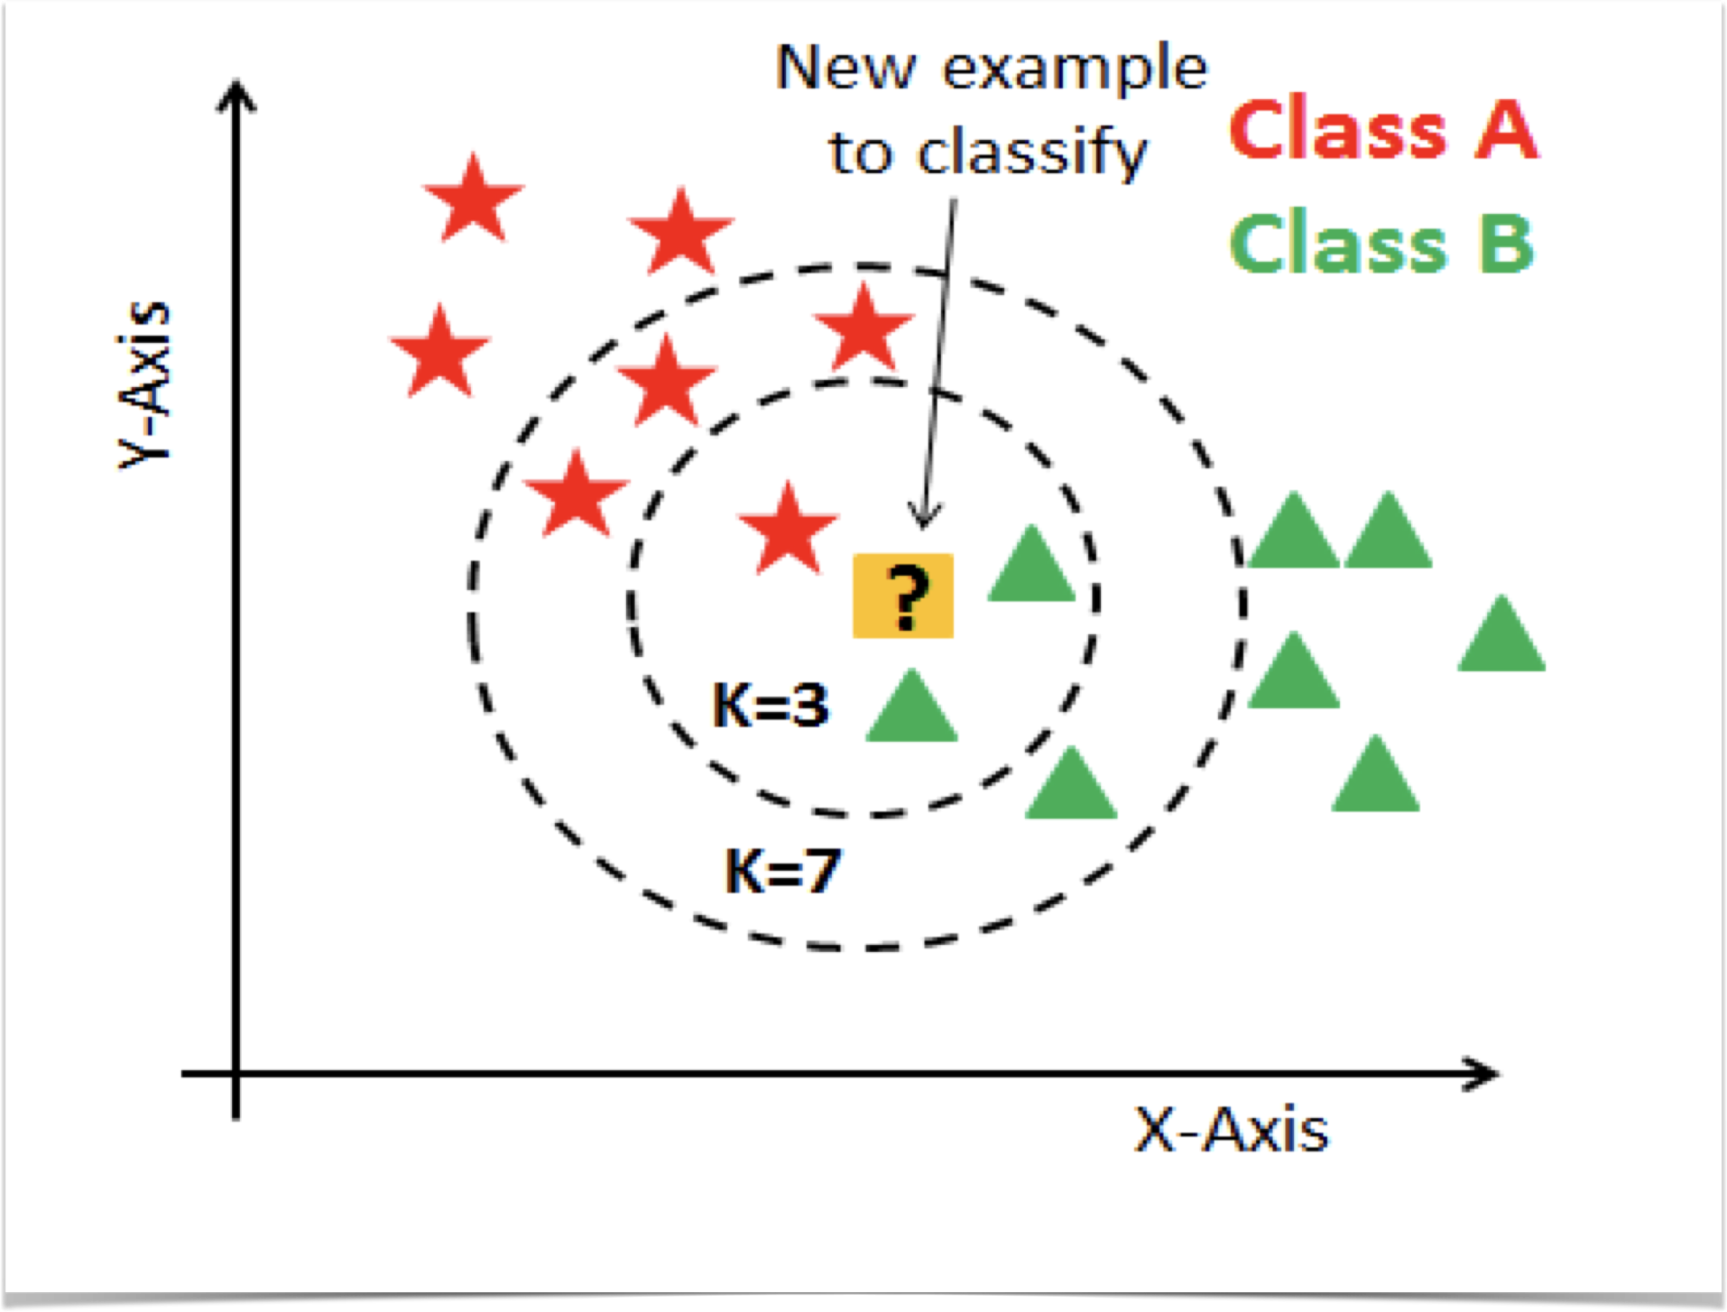
K-Nearest Neighbor

Slide 6
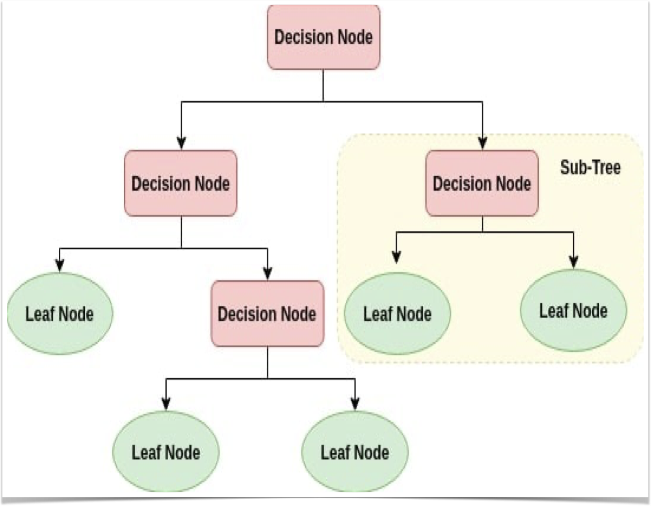
Decision Tree

Slide 7
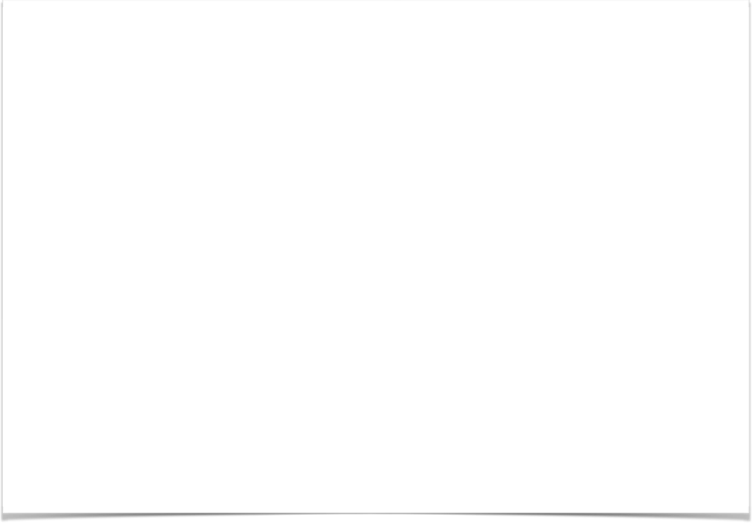
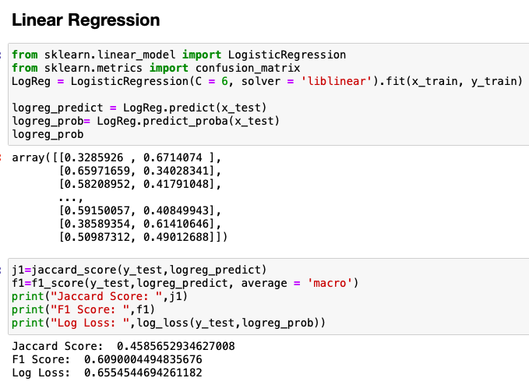
Linear Regression

Slide 8

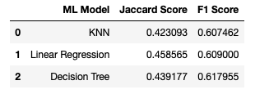
ModelS
Evaluation Metrics used were the Jaccard Score and F1 Score.
Increase Accuracy by using different K-values, max depth, and C values.

Slide 9
Conclusion
Linear Regression is the most accurate model for us to use to predict Accident Severity.
We can use this model to determine what attributes contribute to a higher risk of being involved in a car accident and how severe the accident may be.
Officials could use this information to make decisions to reduce risk and harm.

